Slide 1






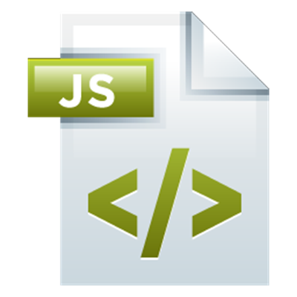
Introduction to TypeScript & Angular
Why Angular & How To Get Started
Angular Development
SoftUni Team
Technical Trainers
Software University
http://softuni.bg

Slide 2

Table of Contents
Why Angular?
Why Angular is better than the others
Introduction to TypeScript
Installation
A simple process to get started
Building our first application
The usual Hello World app

Slide 3
Have a Question?
sli.do #angular-js

Slide 4
Why Angular?
What The Fuzz Is All About

Slide 5
Why Angular?
Angular is:
Easy to learn
Modern codebase
Component-based
Uses TypeScript
IDE friendly
Performance oriented
Mobile first

Slide 6
Why Angular?
Reasons to use Angular:
Solid community
Backed by Google
MVC pattern
Good flexibility
Dependency injection
Saves a lot of time
Effective data binding

Slide 7
Introduction To TypeScript
A JavaScript superset

Slide 8
Introduction To TypeScript
Install globally TypeScript
Open your IDE (Visual Studio Code understands TS)
Create your first ".ts" file
Write some TypeScript
Run the compiler
You have JavaScript
npm install -g typescript
tsc myfile.ts

Slide 9
Introduction To TypeScript
Lets start with simple JavaScript
function Greeter(greeting) {
this.greeting = greeting;
}
Greeter.prototype.greet = function() {
return "Hello, " + this.greeting;
}
let greeter = new Greeter("world");
let greeting = greeter.greet();
console.log(greeting)

Slide 10
Introduction To TypeScript
Adding types
function Greeter(greeting: string) {
this.greeting = greeting;
}
Greeter.prototype.greet = function() {
return "Hello, " + this.greeting;
}
let greeter = new Greeter("world");
let greeting = greeter.greet();
console.log(greeting)

Slide 11
Introduction To TypeScript
Adding classes
class Greeter {
private greeting: string;
constructor (greeting: string) {
this.greeting = greeting
}
greet () {
return 'Hello, ' + this.greeting
}
}
let greeter = new Greeter('world')
let greeting = greeter.greet()
console.log(greeting)

Slide 12
Introduction To TypeScript
Adding interfaces
interface Person {
firstName: string,
lastname: string
}
function sayHello (person: Person) {
return 'Hello from ' + person.firstName + ' ' + person.lastname
}
let hello = sayHello({
firstName: 'Ivaylo',
lastname: 'Kenov'
})
console.log(hello)

Slide 13
Introduction To TypeScript
Adding unions
type nameOrNameArray = string | string[];
function sayHello (name: nameOrNameArray) {
if (typeof name === 'string') {
console.log(name);
} else {
console.log(name.join(' '));
}
}
sayHello(['Ivaylo', 'Kenov'])

Slide 14
Introduction To TypeScript
Other features
private, public or protected modifiers
readonly modifier
get or set for properties
static methods and properties
abstract classes
enum data type
and many more here: https://www.typescriptlang.org/docs/handbook/basic-types.html

Slide 15
Let's Install It
It's very simple actually

Slide 16
Creating A New App
Pretty easy actually
Install globally @angular/cli
Use it like this
These commands will start a dev server on port 4200
To make production build just run
More here: https://github.com/angular/angular-cli/wiki
npm install -g @angular/cli
ng new some-app
cd some-app
npm install
ng serve
ng build --prod
ng serve --prod

Slide 17
What About The IDE?
We will use Visual Studio Code
But you may use whichever IDE you prefer
You don't need to install anything specifically
It supports TypeScript out of the box
By using the Angular CLI
You do not need to use a linter
You do not need install any specific plugin
Everything is included

Slide 18
Let's Hack Some Code
A simple Hello World!

Slide 19








JavaScript Web – Angular Fundamentals
https://softuni.bg/courses/angular-2-fundamentals

Slide 20

License
This course (slides, examples, demos, videos, homework, etc.) is licensed under the "Creative Commons Attribution-NonCommercial-ShareAlike 4.0 International" license
Attribution: this work may contain portions from
"End-to-end JavaScript Applications" course by Telerik Academy under CC-BY-NC-SA license

Slide 21





Free Trainings @ Software University
Software University Foundation – softuni.org
Software University – High-Quality Education, Profession and Job for Software Developers
softuni.bg
Software University @ Facebook
facebook.com/SoftwareUniversity
Software University @ YouTube
youtube.com/SoftwareUniversity
Software University Forums – forum.softuni.bg

